Slide 1

AI Term Project
Shivani Mathur

Slide 2
A Movie Recommender System
Using Deep Reinforcement Learning, with more than one type of filtering technique
Project Topic

Slide 3
The objective of this project is to build a Movie Recommendation system with Deep Reinforcement Learning to understand its implementation and try to incorporate a hybrid movie filtering technique.
Objective

Slide 4
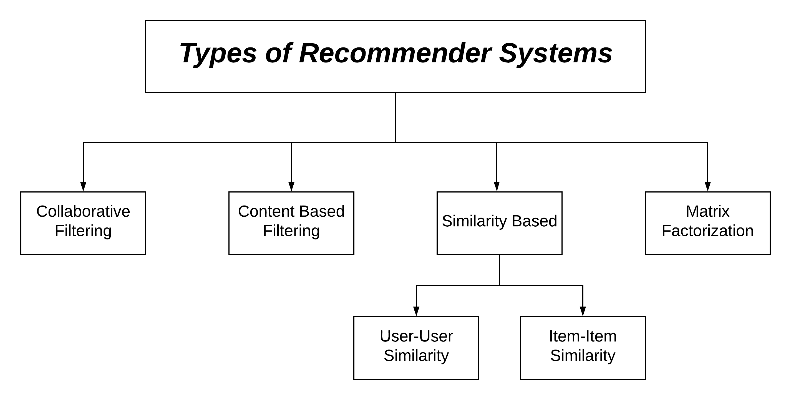
I will be building my recommender by understanding the basic baseline recommendation systems developed upon RL.
I will also read upon how Netflix or Amazon or other streaming channels have developed their RS.
Approach

Slide 5
1. I will be submitting my code along with a descriptive report of its working.
2. It will have sample inputs and outputs used for testing and training the system.
3. I will also present a demo of the entire project.
Deliverables

Slide 6
My system can be evaluated on its recommendation accuracy based on the various filtering techniques.
Evaluation methodology

